Slide 1

Azure Functions A somewhat-deep dive
Twin Cities PowerShell User Group
Dan O’Sullivan
July 2019

Slide 2
Azure Functions: “an event-driven serverless compute platform that can also solve complex orchestration problems”
But what is “serverless”?

Slide 3
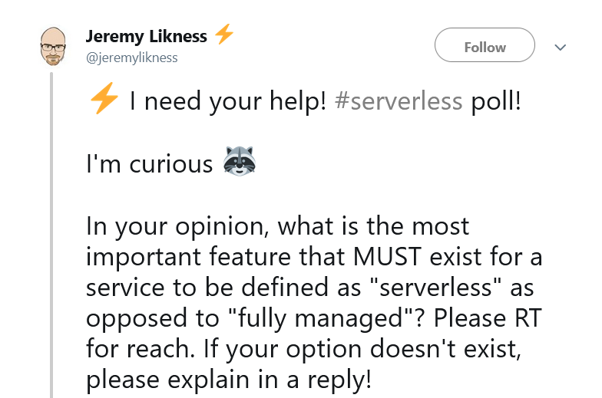

Slide 4
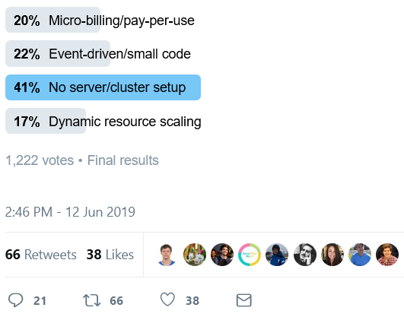

Slide 5
The Good Old Days / The Dark Ages
Code
Application
Operating System
Hardware

Slide 6
Virtualization
Code
Application
Operating System
Hardware

Slide 7
Containerization
Code
Application
Operating System
Hardware

Slide 8
Serverless
Code
Application
Operating System
Hardware

Slide 9
My background
Desktop management, automation
PowerShell, SCCM, Intune, O365, WMI, .NET, Azure
Not really a developer
Or an Ops person
Not from these here parts

Slide 10
Azure Functions runtime versions
Language | 1.X runtime | 2.X runtime
C# | GA (.NET Framework 4.7) | GA (.NET Core 2.2)
JavaScript | GA (Node 6) | GA (Node 8 & 10)
F# | GA (.NET Framework 4.7) | GA (.NET Core 2.2)
Java | N/A | GA (Java 8)
PowerShell | Experimental | Preview (PowerShell Core 6)
Python | Experimental | Preview (Python 3.6)
TypeScript | Experimental | GA (supported through transpiling to JavaScript)
Bash | Experimental | N/A
Batch (.cmd, .bat) | Experimental | N/A
PHP | Experimental | N/A

Slide 11
Azure Functions scale and hosting
Consumption plan (default option) | Premium plan (preview) / Dedicated (App Service) plan
Pay when your functions are running | “Predictable pricing”
Don’t pay for idle VMs / don’t need to reserve capacity | -
Scale up compute power automatically | Premium only
No concurrency | Concurrency on Premium and some Dedicated VMs
Cold start can cause delays | Pre-warmed instances / Always On available
10 minute maximum timeout | No maximum timeout

Slide 12
Azure Functions triggers and bindings
Example scenario | Trigger | Input binding | Output binding
A new queue message arrives which runs a function to write to another queue. | Queue 1 | None | Queue 2
A scheduled job reads Blob Storage contents and creates a new Cosmos DB document. | Timer | Blob Storage | Cosmos DB
The Event Grid is used to read an image from Blob Storage and a document from Cosmos DB to send an email. | Event Grid | Blob Storage and Cosmos DB | SendGrid
A webhook that uses Microsoft Graph to update an Excel sheet. | HTTP | None | Microsoft Graph

Slide 13
Demo: create Function App in Azure console
Function App settings
Runtime version
Host Keys
Configuration -> General settings
Platform
HTTP version
Configuration -> Application settings
exposed as environment variables

Slide 14
Demo: PowerShell docs
Create your first PowerShell function in Azure (preview)
Debug PowerShell Azure Functions locally
Azure Functions PowerShell developer guide

Slide 15
Demo: prerequisites
Visual Studio Code
Azure Functions extension
PowerShell extension
PowerShell Core 6.2
.NET Core 2.x SDK for Windows
Azure Functions Core Tools
Azure account
Storage Account (Azure Blob, Queue, Files, and Table storage)
This sounds like a lot, but it’s easy if you follow the docs.

Slide 16
Function App folder structure
One folder per Function
run.ps1 is what gets run
function.json defines:
triggers, input binding, output binding
Modules folder
goes in $env:PSModulePath
host.json
Function App configuration
e.g. logging level
profile.ps1
runs when a Function App starts
(first deployed or cold start)
requirements.psd1
defines Az module as a “managed dependency”
PSFunctionApp
| - MyFirstFunction
| | - run.ps1
| | - function.json
| - MySecondFunction
| | - run.ps1
| | - function.json
| - Modules
| | - myFirstHelperModule
| | | - myFirstHelperModule.psd1
| | | - myFirstHelperModule.psm1
| | - mySecondHelperModule
| | | - mySecondHelperModule.psd1
| | | - mySecondHelperModule.psm1
| - local.settings.json
| - host.json
| - requirements.psd1
| - profile.ps1
| - extensions.csproj
| - bin

Slide 17
Demo demo demo
a_HelloWorld
b_LocalDebug
c_ShellOut
d_ExploreAzureEnvironment
e_FileSystemBrowser
Code is on GitHub

Slide 18
email: twitter: web: | dan@osull.com @dan_osull_com blog.osull.com

